Slide 1

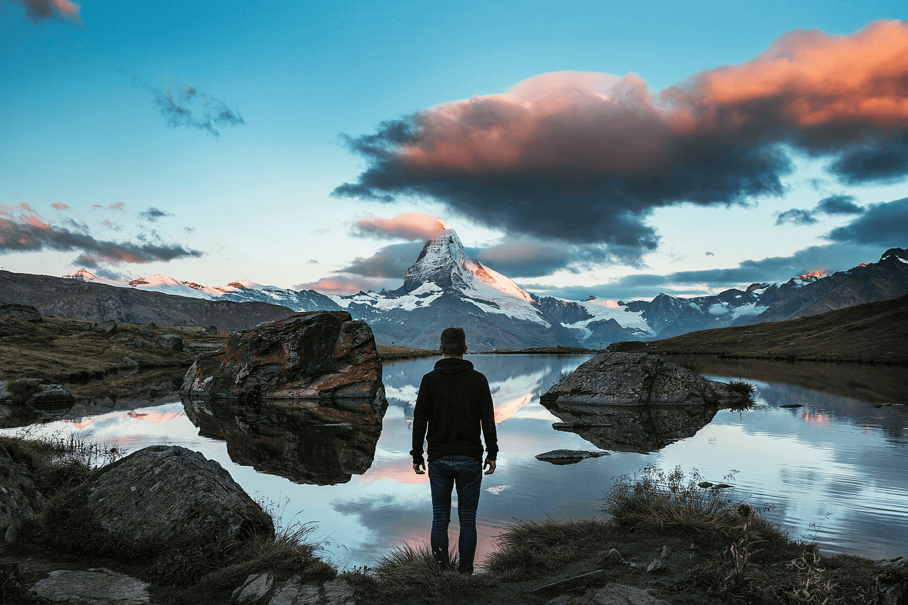


WE DON'T JUST FOLLOW WEB DESIGN TRENDS. AVALANCHE ARE THE PEOPLE WHO SET THEM...

Slide 2
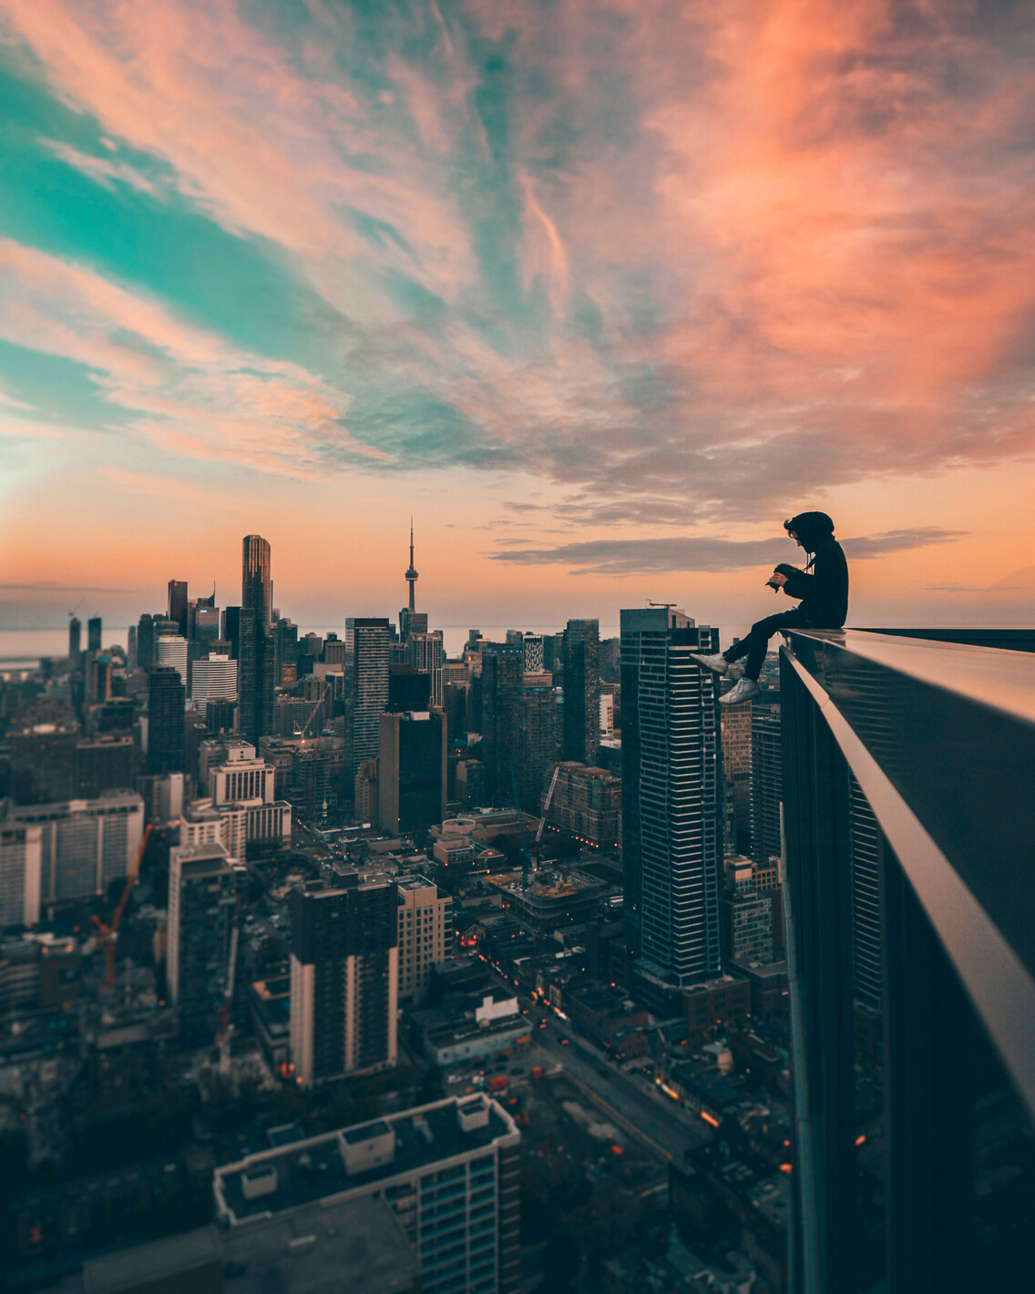
TABLE
of contents
Website Innovation
Conversion Rates
Design & Creativity
Compliance & Accessibility
Community Communication
Why Choose Us

Slide 3



WEBSITE INNOVATION
CUSTOM BUILT
SEO POWERHOUSE
REGULAR CONTENT
The Avalanche website is completely coded from scratch using HTML5. It is fully WCAG compliant and accessible for all users without losing key elements on browsing.
The Avalanche site has one of the strongest SEO presences in Ireland with a MOZ Domain Authority of 68.
https://www.independent.ie/ has a score of 90 for reference.
Our blog is updated weekly with articles for our audience/clients further improving our SEO reach, advertising campaigns and off-site marketing with a content plan already in place for 2024.

Slide 4
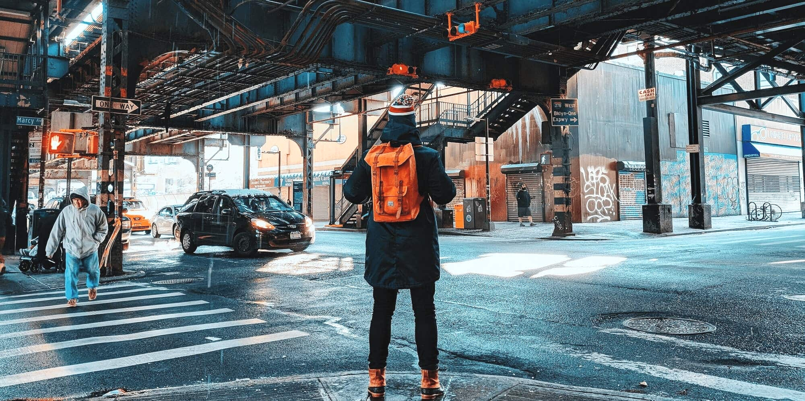
CONVERSION RATES
In the last 12 months, Avalanche have won an unprecedented amount of business & published 93 full websites in the calendar year, a record for us & a rate of a new project being published every 3.9 days, all whilst retaining the Avalanche seal of quality. The Avalanche site is a key part of this as it showcases our level of work even before initial contact.
89%
500+
Nearly 90% of projects are eCommerce led with the majority Irish based businesses ranging from major companies like Fenergo, DigitalWell to SMEs all over Ireland.
Avalanche has also evolved into one of the highest-rated agencies worldwide with over 500 5-star reviews showcasing our capabilities & ability to cultivate lasting relationships.

Slide 5
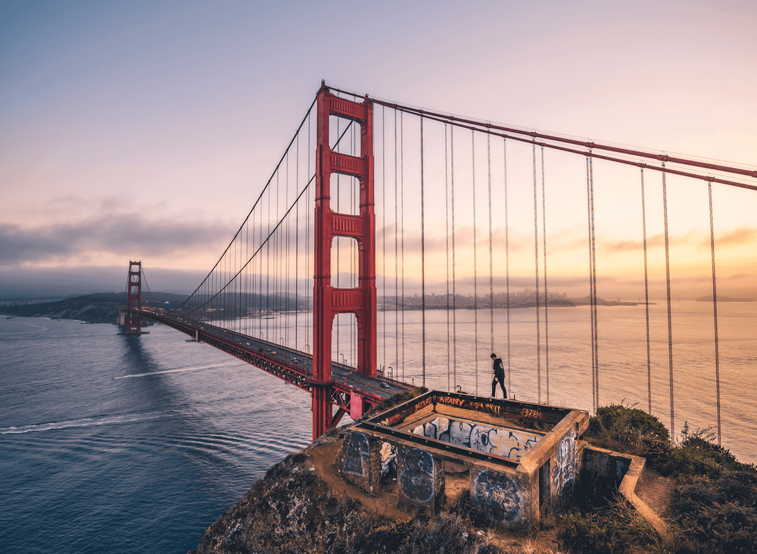
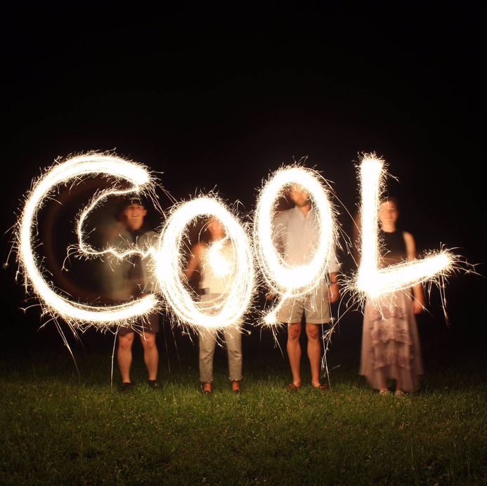
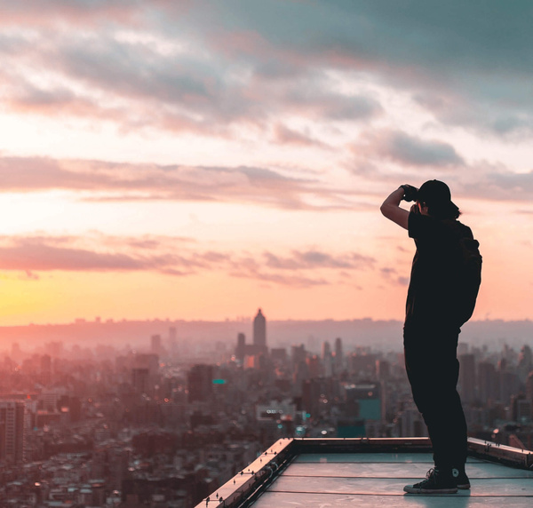
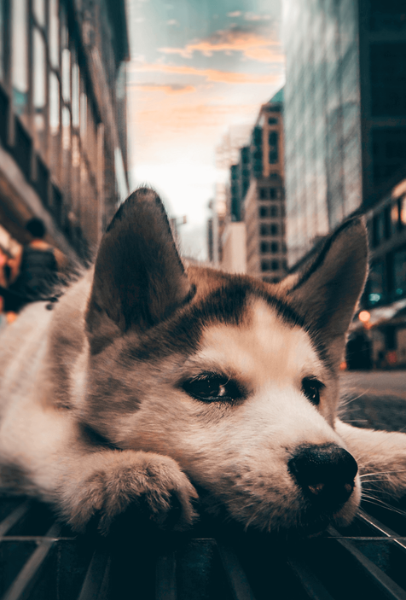

DESIGN & CREATIVITY
STEP 1 - AESTHETIC DESIGN
As with all our projects, the first step is to get the general aesthetic in place & for the Avalanche site, we wanted a contemporary, visually led site that ensured that potential clients were impressed on landing about the Avalanche brand & how we can use our creative talents for their business.
STEP 2 - SEARCH ENGINE OPTIMISATION
Once the visual & overall design was in place, we had to alloy that with our SEO techniques to ensure that the site builds on existing SEO structures that we have worked on over several years resulting in a strong MOZ score that has created a strong organic presence without sacrificing the aesthetic quality that has become our benchmark.
STEP 3 - COMPRESSION & CONTENT
The final step in the Avalanche site and indeed, on all of our projects was to install a custom compression system using our unique .htaccess files, add a CDN for speeds, compress imagery, install self-generating sitemaps & tweak speeds to maximum. In 2023, we have also created a self generating blog using ChatGPT which we are very excited about in terms of content.

Slide 6
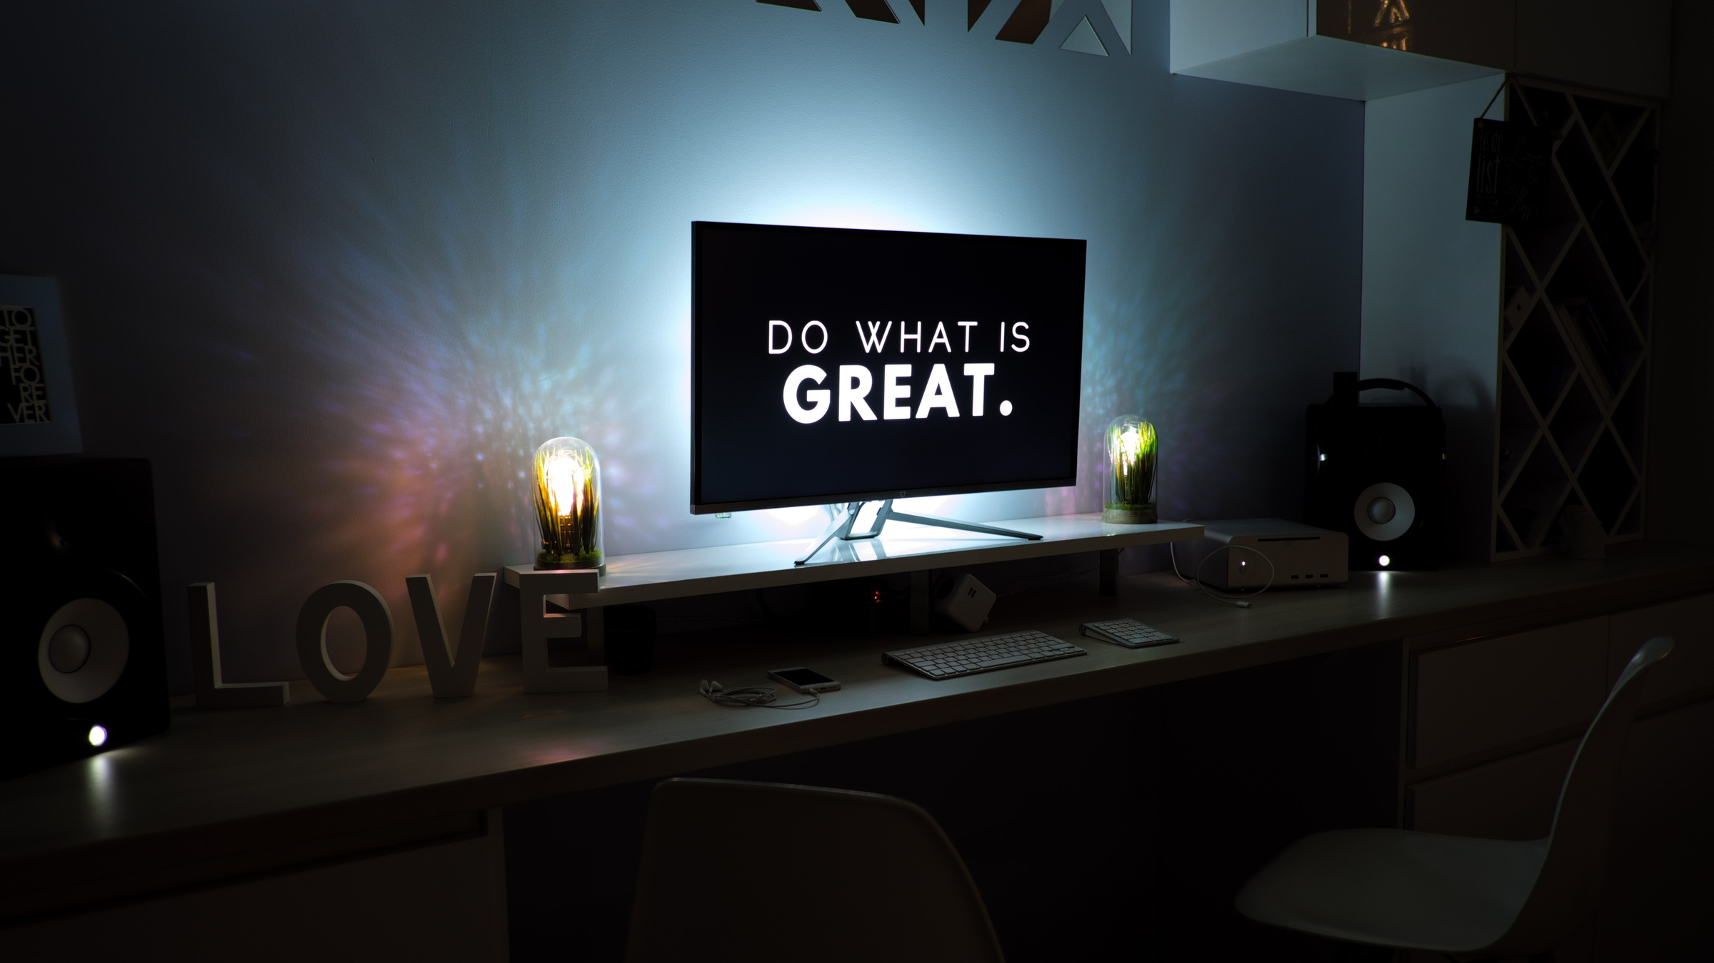
COMPLIANCE & ACCESSIBILITY
GDPR
01
As a development agency, we have a strong responsibility to ensure our work is fully GDPR compliant and to guide clients to same. This begins with the Avalanche site which is fully compliant with all regulations.
PRIVACY & SAFETY
02
In the age of data protection, it is imperative that all users feel safe and can choose to not provide any details if uncomfortable. The Avalanche site does not collect any details besides those willingly put forth in lead generation.
03
ACCESSIBILITY
Accessibility & WCAG compliance is a fast growing area of web development & we try to ensure all sites are accessible for users. Whilst not possible on all projects due to client needs etc, I would hope this would follow GDPR protocol and become a necessity in the years to come. We are proud to say the Avalanche site is accessible for all.

Slide 7
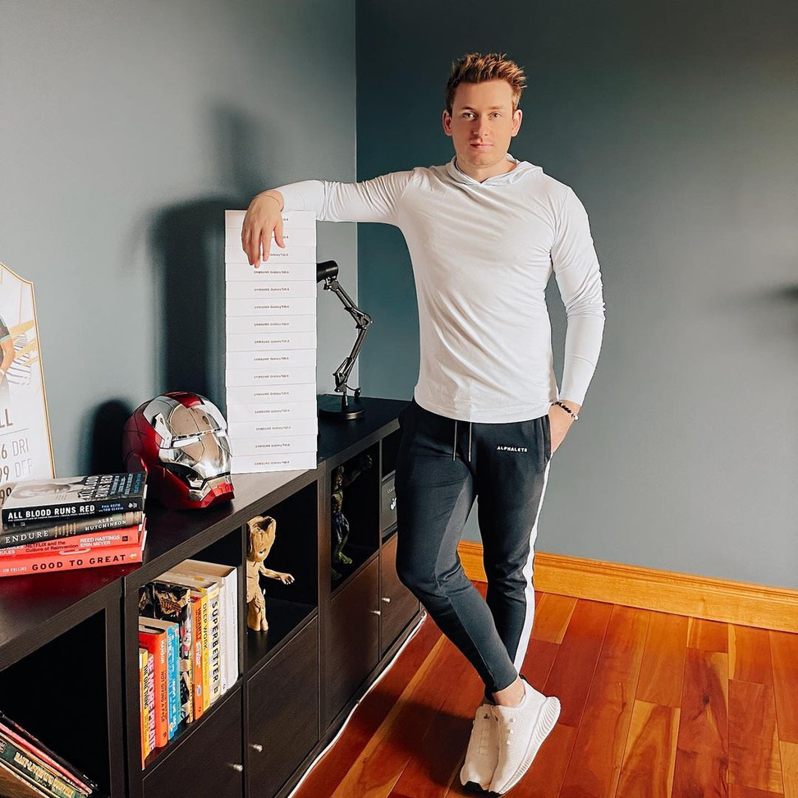
COMMUNITY
COMMUNICATION
We do things differently at Avalanche than most agencies & form long lasting relationships with our clients, I think that ia why we have grown to the level we have, with our community/charity interests firmly at the core of what we do.
Alongside our day to day work, we have managed to donate over €500,000 in funds/technology to local groups/clubs & schools all over Kerry in the last 10 years. This work is what I am most proud of and something we plan to continue in the years to come at Avalanche.
One of my favourite examples of this was being able to donate 15 Samsung tablets to my local national school during lockdown. You can read more on this and similar stories on our site.

Slide 8
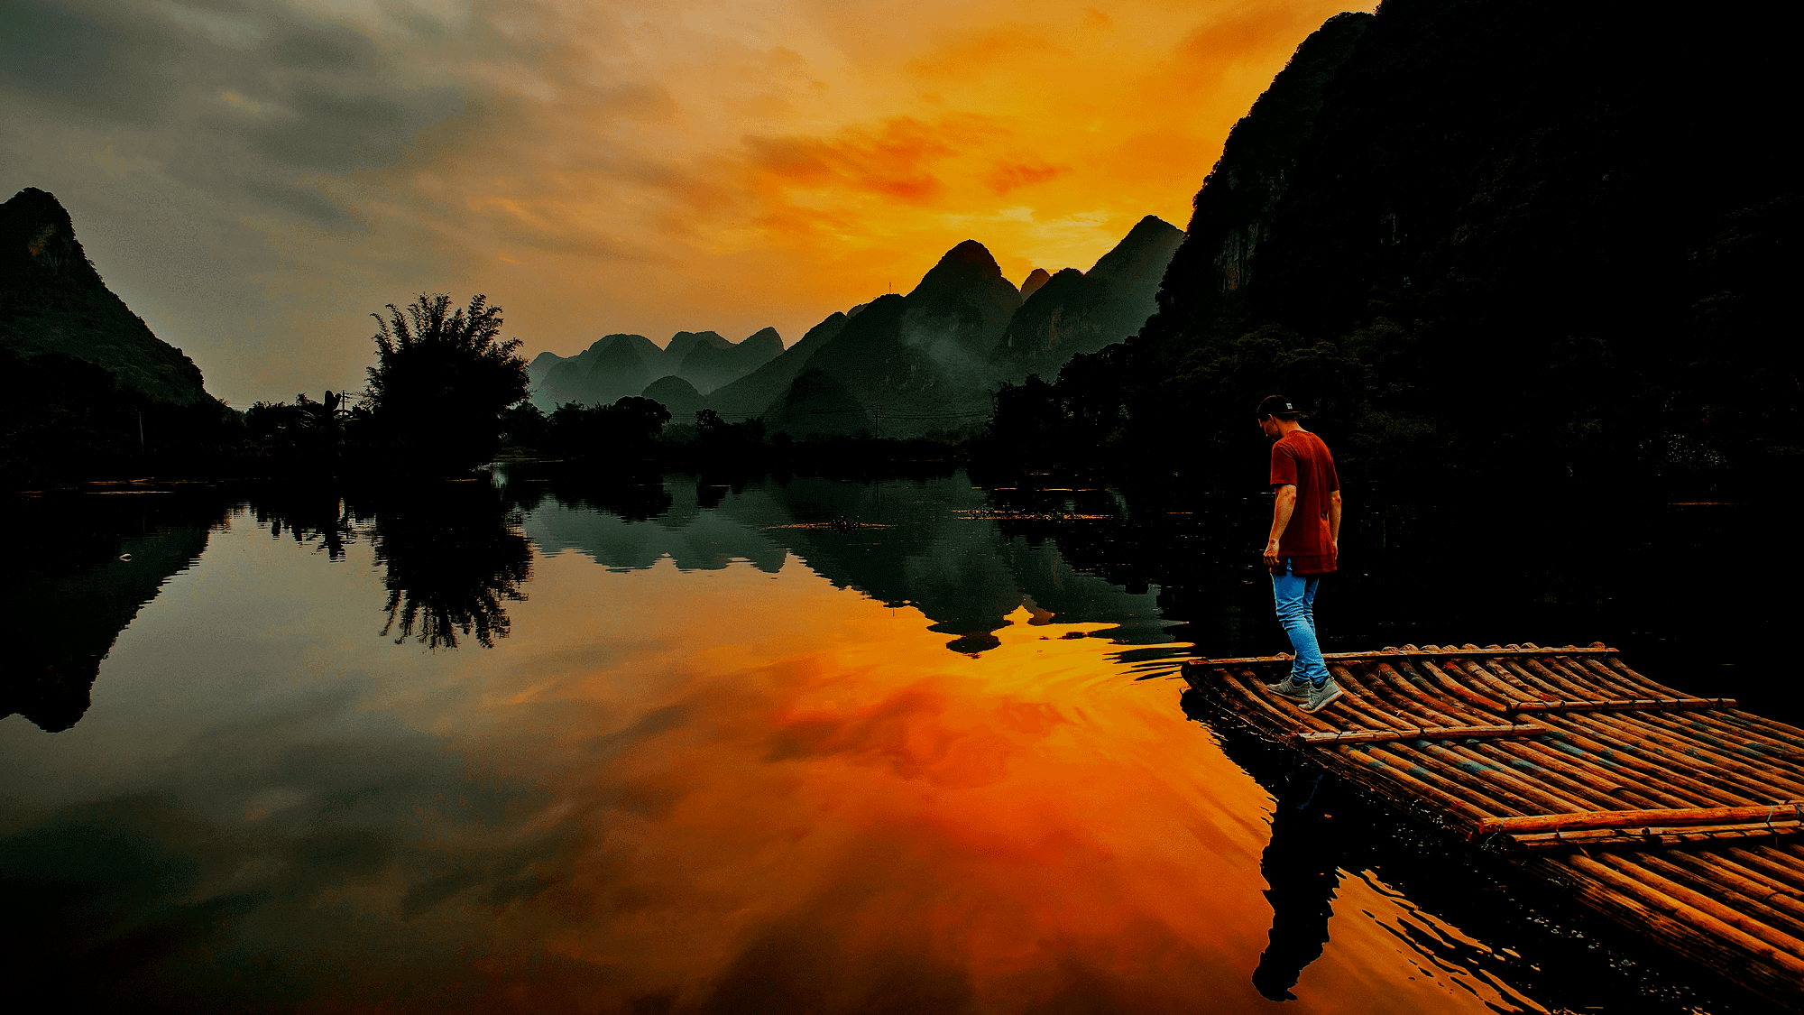
"HERE'S TO THE CRAZY ONES..THE MISFITS. THE REBELS. THE TROUBLEMAKERS. BECAUSE THE PEOPLE WHO ARE CRAZY ENOUGH TO THINK THEY CAN CHANGE THE WORLD, ARE THE ONES WHO DO."

Slide 9
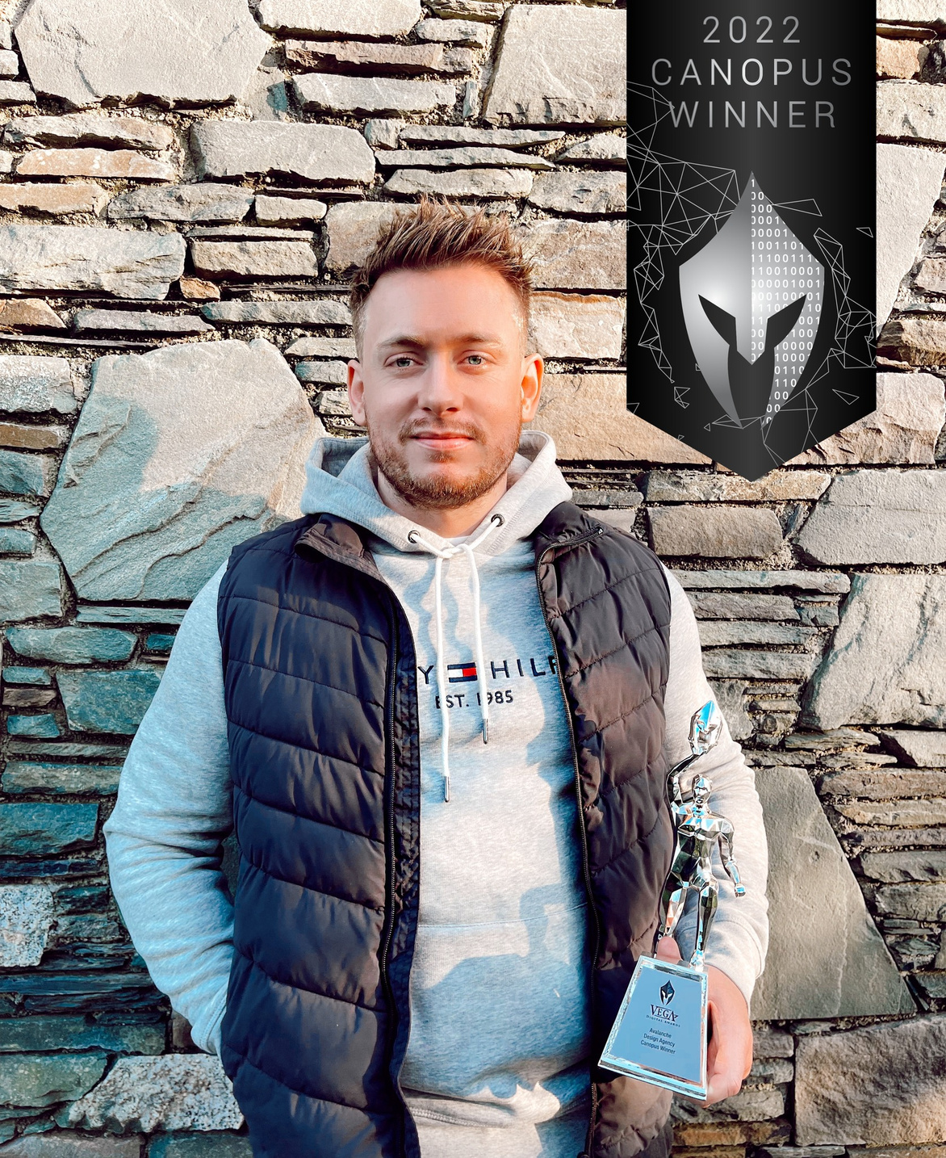
WHY CHOOSE AVALANCHE?
As mentioned in previous sections, our results & client satisfaction speak for themselves, in the last 12 months, we published 93 full websites in the calendar year, a record for us & a rate of a new project being published every 3.9 days, all whilst retaining the Avalanche seal of quality we have come to be recognised for the world over.
Avalanche has also evolved into one of the highest-rated agencies worldwide with over 500 5-star reviews (316 Google, 161 Facebook, 28 Bark) showcasing our design capabilities & ability to cultivate lasting relationships with clients.
All of our work/achievements begin with the quality of the Avalanche site & we thank you for the opportunity & wish all our fellow nominees well in the awards process.

Slide 10
THANK YOU FOR
YOUR CONSIDERATION
PROFESSIONAL SERVICES WEBSITE OF THE YEAR
DIGITAL BUSINESS IRELAND - NATIONAL DIGITAL AWARDS 2022

